Slide 1




B.TECH PRE-FINAL PROJECT PRESENTATION 2020-21
TOPIC: To Minimize the Energy Consumption for Communication Protocol using IOT.
Project ID:21116
National Institute of Science & Technology
By
Name:Suman Priya Sahu
Roll NO:201711357
BPUT Reg NO:1701202262
Name:Manisha Panda
Roll NO:201741413
BPUT Reg NO:1701202078
Under the guidance of:
Mr.Rabindra Kumar Shial
Suman Priya Sahu- CSE/201711357 & Manisha Panda- CSE/ 201741413
[1]

Slide 2
B.TECH PRE-FINAL PROJECT PRESENTATION 2020-21
CONTENT
Objective
Predicted Output
Assumption of the protocol design
Simulation Result
Data Visualisation
System Model
Effectiveness of using Hierarchical routing protocol
Future Work and Conclusion.
National Institute of Science & Technology
Suman Priya Sahu- CSE/201711357 & Manisha Panda- CSE/ 201741413
[2]

Slide 3
B.TECH PRE-FINAL PROJECT PRESENTATION 2020-21
OBJECTIVE
Our goal for this project was to use Advance Technology of Wireless Sensor Network in order to develop, analyze and to reduce the amount of energy and power used by communication protocol. We have use LEACH (low Energy Adaptive Clustering Hierarchical Protocol) to reduced energy consumption by each network sensor node.
Characteristics:--
Capacity to handle node failure.
Scalability to large scale of distribution.
Mobility of nodes.
Heterogeneity of the nodes.
National Institute of Science & Technology
Suman Priya Sahu- CSE/201711357 & Manisha Panda- CSE/ 201741413
[3]

Slide 4
B.TECH PRE-FINAL PROJECT PRESENTATION 2020-21
PREDICTED OUTPUT
Deployment of the nodes.
Calculation of the distance among the nodes.
Creating Cluster.
Threshold for Cluster Selection.
Maintaining the power level of the node.
Calculation of the energy consume and network performance by each node.
National Institute of Science & Technology
Suman Priya Sahu- CSE/201711357 & Manisha Panda- CSE/ 201741413
[4]

Slide 5
B.TECH PRE-FINAL PROJECT PRESENTATION 2020-21
ASSUMPTION OF THE PROTOCOL DESIGN
Maximising the lifetime of the sensor network is a major challenge.
In a sensor network, the nodes communicate with each other to pass the information to a data sink.
The nodes will have a limited energy resources and to increase the lifetime of the network, it is necessary to design communication protocols which aim at reducing the consumed power.
A communication protocol is a system of rules that allows two or more entities of a communication system to transmit information.
National Institute of Science & Technology
Suman Priya Sahu- CSE/201711357 & Manisha Panda- CSE/ 201741413
[5]

Slide 6
B.TECH PRE-FINAL PROJECT PRESENTATION 2020-21
SIMULATION RESULT
Parameters
Simulation area
Number of nodes
Base Station coordinates
Initial Energy
Probability to the node to become a CH
Energy for transferring of each bit of data
Energy for receiving of each bit of data
Energy for free space model
Energy for multipath model
Energy for data aggregation
Values
100 X 100 m
100
(50,50)
0.5
0.1
50*0.000000001
50*0.000000001
10*0.000000000001
10*0.000000000001
5*0.000000001
National Institute of Science & Technology
Suman Priya Sahu- CSE/201711357 & Manisha Panda- CSE/ 201741413
[6]

Slide 7
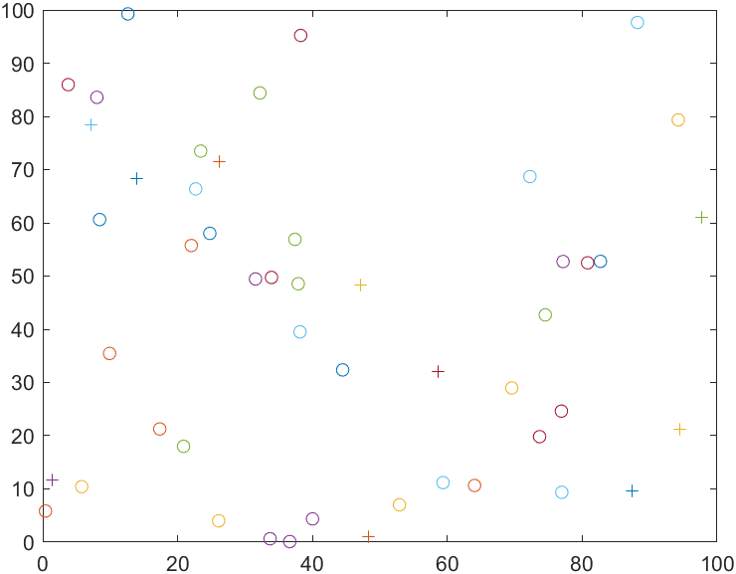
B.TECH PRE-FINAL PROJECT PRESENTATION 2020-21
DATA VISUALISATION
Deployment of nodes
National Institute of Science & Technology
Suman Priya Sahu- CSE/201711357 & Manisha Panda- CSE/ 201741413
[7]

Slide 8
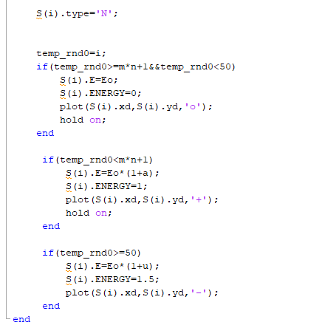

B.TECH PRE-FINAL PROJECT PRESENTATION 2020-21
National Institute of Science & Technology
Selection of cluster head is calculated using this equation:-
temp_rnd<=(p/1-p [ mod(r, 1/p) ] ) where nodes belongs to G
Otherwise 0
Suman Priya Sahu- CSE/201711357 & Manisha Panda- CSE/ 201741413
[8]

Slide 9
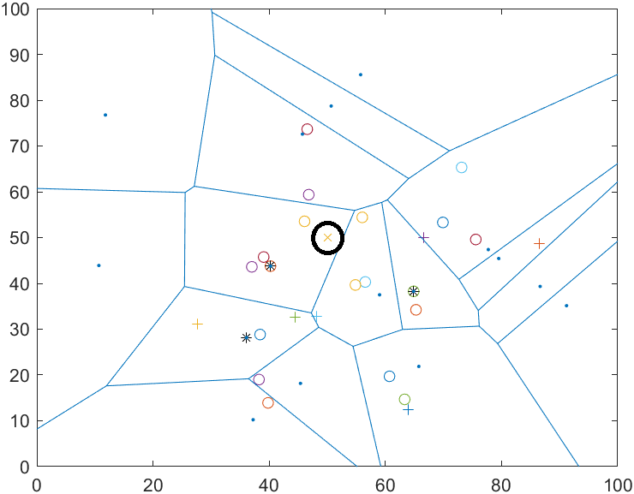
B.TECH PRE-FINAL PROJECT PRESENTATION 2020-21
DATA VISUALISTION
National Institute of Science & Technology
X – base station
O - normal nodes
+ - Advance node
. – Intermediate node
* - Cluster head
Suman Priya Sahu- CSE/201711357 & Manisha Panda- CSE/ 201741413
[9]

Slide 10
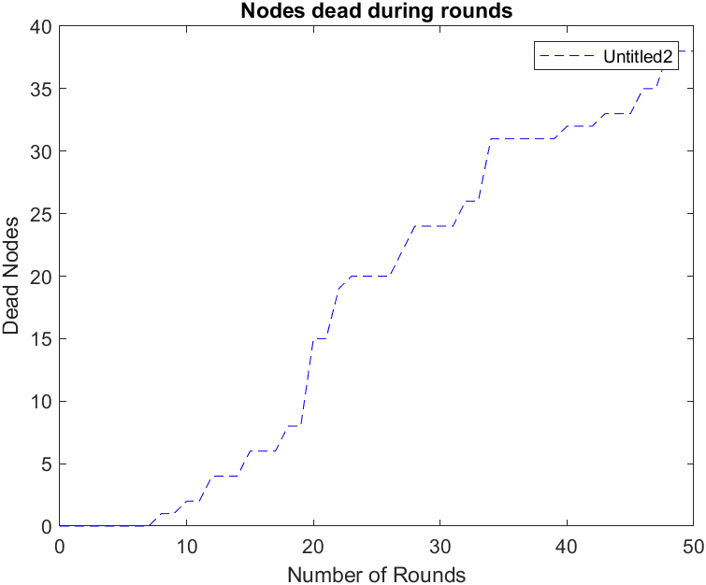
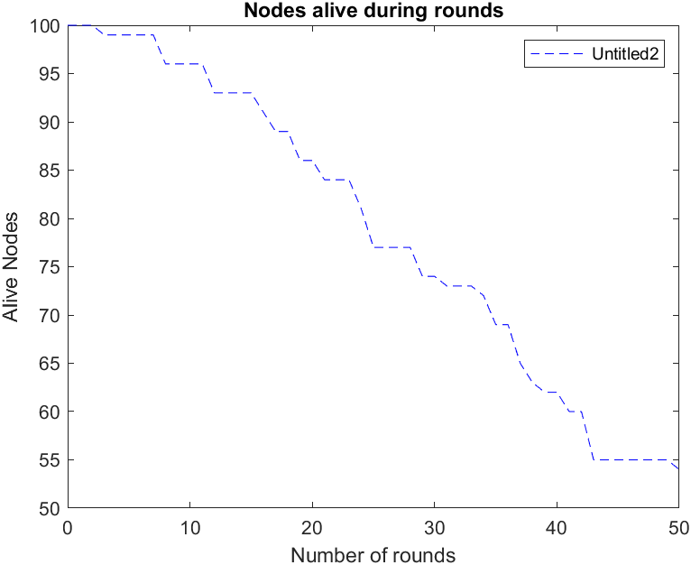
B.TECH PRE-FINAL PROJECT PRESENTATION 2020-21
DATA VISUALISATION
National Institute of Science & Technology
Suman Priya Sahu- CSE/201711357 & Manisha Panda- CSE/ 201741413
[10]

Slide 11
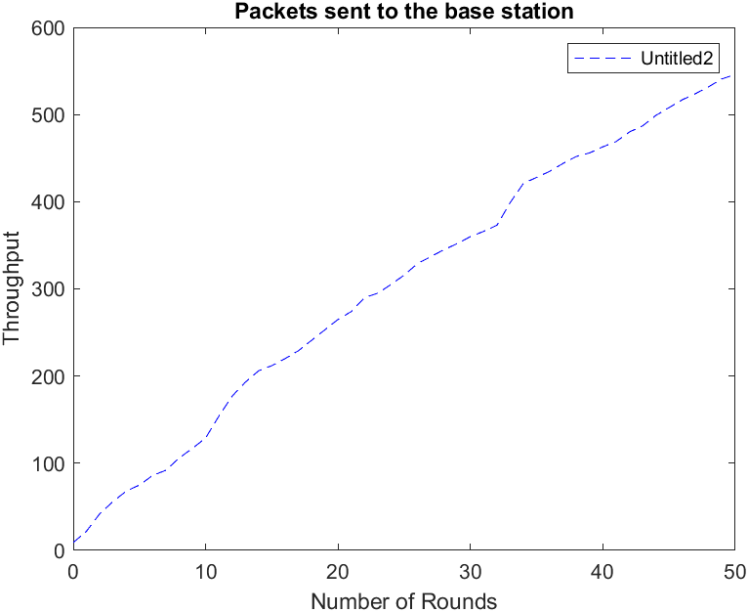
B.TECH PRE-FINAL PROJECT PRESENTATION 2020-21
DATA VISUALISATION
The amount of transmitted data and the total quantity of data sent from the nodes in the WSN to base station calculated by:
Data =dataCHtoBS + dataNtoBS,
National Institute of Science & Technology
Energy dissipated in data transmission is being estimated by:-
𝐸𝑇𝑋= {𝑘 ∗ 𝐸elect + 𝑘 ∗ 𝜀fs ∗ 𝑑^2 if 𝑑 ≤ 𝑑𝑜,
𝑘 ∗ 𝐸elect + 𝑘 ∗ 𝜀mp ∗ 𝑑^4 if 𝑑≥do,
Energy dissipation while reception is:-
𝐸𝑅𝑋= 𝑘 ∗ 𝐸elec.
Suman Priya Sahu- CSE/201711357 & Manisha Panda- CSE/ 201741413
[11]

Slide 12
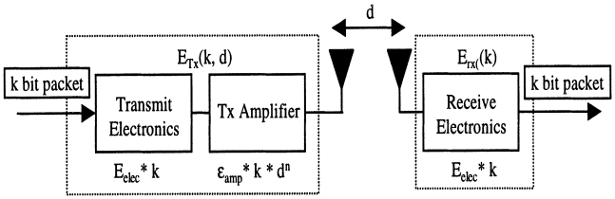
B.TECH PRE-FINAL PROJECT PRESENTATION 2020-21
SYSTEM MODEL
Nodes are dispersed randomly 100 x 100 square unit region following a uniform distribution.
If all the nodes sends hello message to the base station that containing their local information.
It initial taking the optimum value with the node density.
Here the base station is a node with enhanced computation capabilities.
A simple radio energy dissipation model is transmitting a K-bit messages over a distance d to achieve an acceptable ratio/signal.
National Institute of Science & Technology
Suman Priya Sahu- CSE/201711357 & Manisha Panda- CSE/ 201741413
[12]

Slide 13
B.TECH PRE-FINAL PROJECT PRESENTATION 2020-21
EFFECTIVENESS OF ROUTING PROTOCOL
Low Latency.
Probability selection of cluster head.
Aggregation of the data by cluster head.
Collision of nodes is being avoided.
Energy dissipation is uniform.
Shortening of the transmission distance.
National Institute of Science & Technology
Suman Priya Sahu- CSE/201711357 & Manisha Panda- CSE/ 201741413
[13]

Slide 14
B.TECH PRE-FINAL PROJECT PRESENTATION 2020-21
FUTURE WORK
The implementation of future work include that taking an account of the impact on network lifetime and to design an energy consumption while data transmission.
We have used a approach to promote highly effective communication protocol. By this energy efficient protocols, it is found that the proposed algorithm performs better in terms of stability period and network lifetime in different scenarios of area, energy and node density.
National Institute of Science & Technology
Suman Priya Sahu- CSE/201711357 & Manisha Panda- CSE/ 201741413
[14]

Slide 15
B.TECH PRE-FINAL PROJECT PRESENTATION 2020-21
REFERENCE
R.P. Mahapatra and R.K. Yadav, "Descendant of LEACH based routing protocols in wireless sensor networks", Procedia Comput. Sci., vol. 57, pp. 1005-1014, 2015.
L. Yadav and C. Sunitha, "Low energy adaptive clustering hierarchy in wireless sensor network (LEACH)", Int. J. Comput. Sci. Inf. Technol., vol. 5, no. 3, pp. 4661-4664, 2014.
National Institute of Science & Technology
Suman Priya Sahu- CSE/201711357 & Manisha Panda- CSE/ 201741413
[15]

Slide 16
B.TECH PRE-FINAL PROJECT PRESENTATION 2020-21
THANK YOU
National Institute of Science & Technology
Suman Priya Sahu- CSE/201711357 & Manisha Panda- CSE/ 201741413
[16]

